Slide 1

Group 2 Project Presentation
Homemade Happenings
- Our Planner Application
Spring 2024 - Systems/Software Analysis and Project
Instructor: Leah Osborne
Slides, Application, and Project created by:
Xander Jewell, Makaila White, Thomas Warenski, Tanner Hadley

Slide 2
Various Documents We Created
Requirements Document
Feasibility Study Document
Project Plan Document
Risk Assessment Document
Design Document
User Documentation

Slide 3
Requirements Document Key Sections
User Requirements: Home Page, Login Page, Budget Page, To-Do Page, Contact Page, Overview Page, and Details Page (found later)
System Architecture: Python, Tkinter, and SQLite3. We were able to use these in our program to our advantage.
System Evolution: Goal was to be fully operational in 4 to 5 weeks. We were mostly able to do this, as we have most done, but are now finalizing everything.
Development Life Cycle: Requirements, Analysis, Design, Coding, Testing, Deployment, and Review. We were able to follow this life cycle, as it allowed our group to deliver a great product.

Slide 4
Feasibility Study Key Sections
Operation/Technical Feasibility and Legality of our Project Plan: We found that the plan was both legal and operationally/technically feasible and would be a wise project plan to follow.
Does the system contribute to the overall objectives of the organization?: The goal of the project was to create an application that would help people in their everyday life and we believe that we are able to do that with this program
Can the system be implemented within the schedule and budget using current technology?: We found that we would be able to do it with the allotted time and budget we were given. This assessment was true as we did complete the project within the given time and budget.

Slide 5
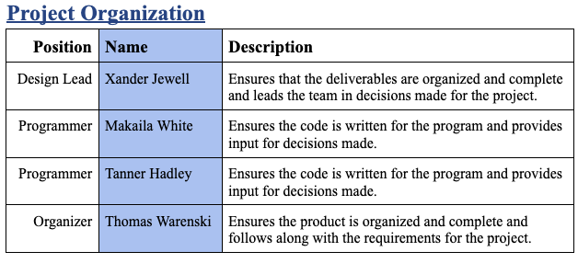
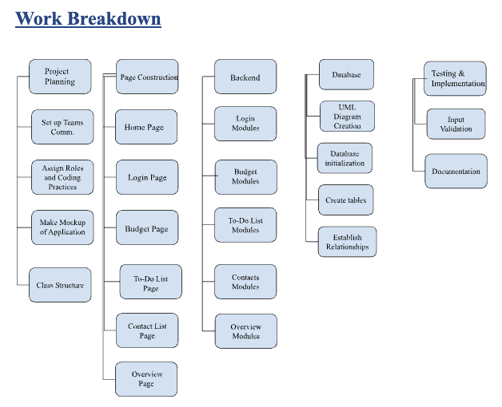
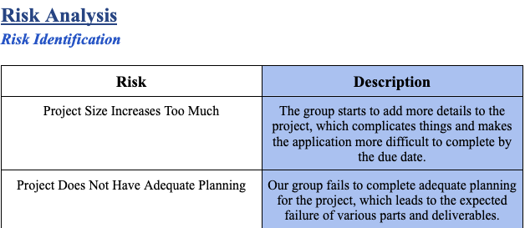
Project Plan Key Sections
Divided Project Responsibilities
Found Possible Risks
Work Breakdown Structure

Slide 6
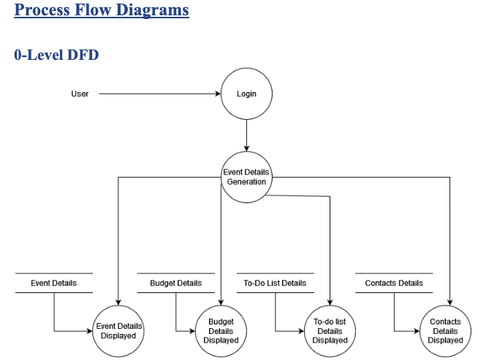
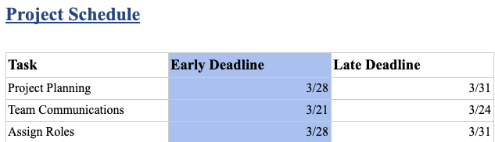
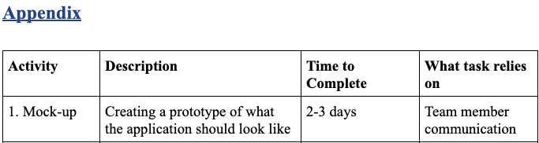
Project Plan Key Sections (cont.)
Created the Project Schedule
Developed Various Process Flow Diagrams
Created Appendix

Slide 7
Risk Assessment Key Sections
Some Risks that We Identified:
Project Size Increases Too Much
The Team is not Skilled Enough
The Team begins to Crunch Regularly
Probability of Those Risks:
Low: The Team will follow the guidelines we have created
Moderate: The Team has used Python and Tkinter, but it has been a while
Low: Each team member is very dedicated to getting project done on time
Effect of Those Risks:
Serious: This could lead to a project that is impossible to complete by due date
Serious: This could lead the group being set back due to inability to complete certain tasks
Serious: This could lead group members to become less interested and a decrease in project quality

Slide 8
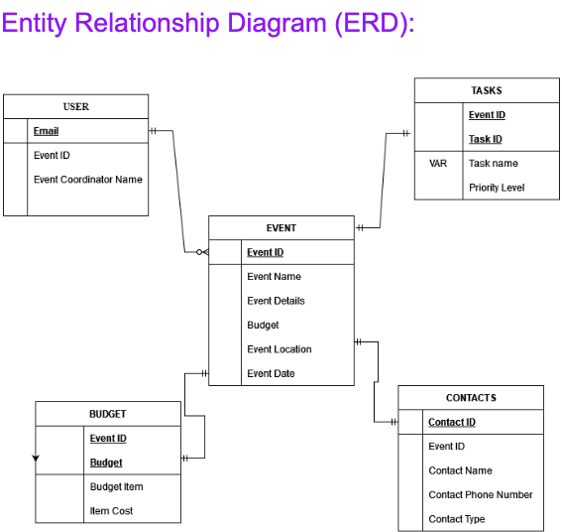
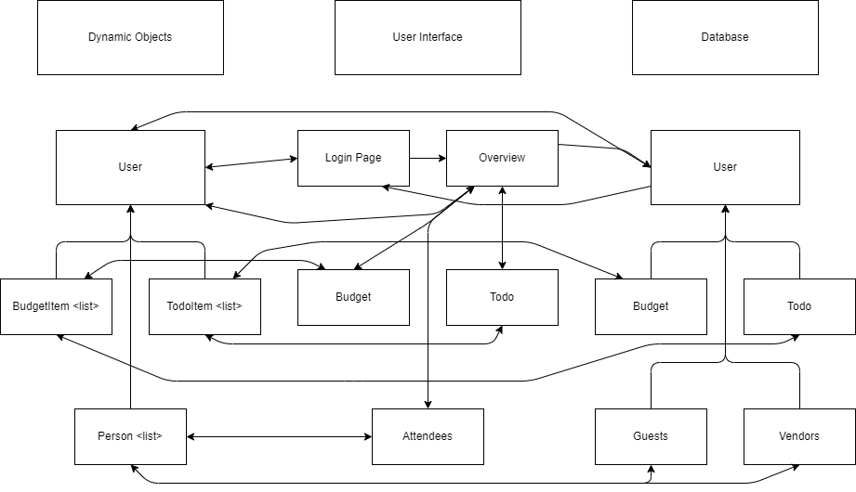
Design Document Key Sections
Created the Entity Relationship Diagram
Created the Architecture Design Diagram

Slide 9
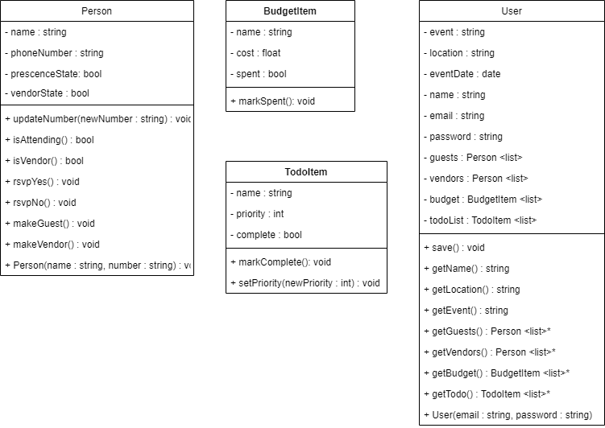
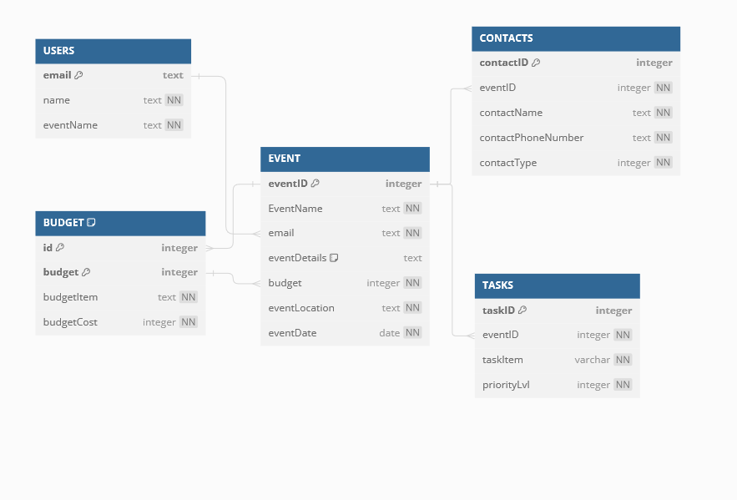
Design Document Key Sections (cont.)
Created the Class Diagram
Created the Database Design

Slide 10
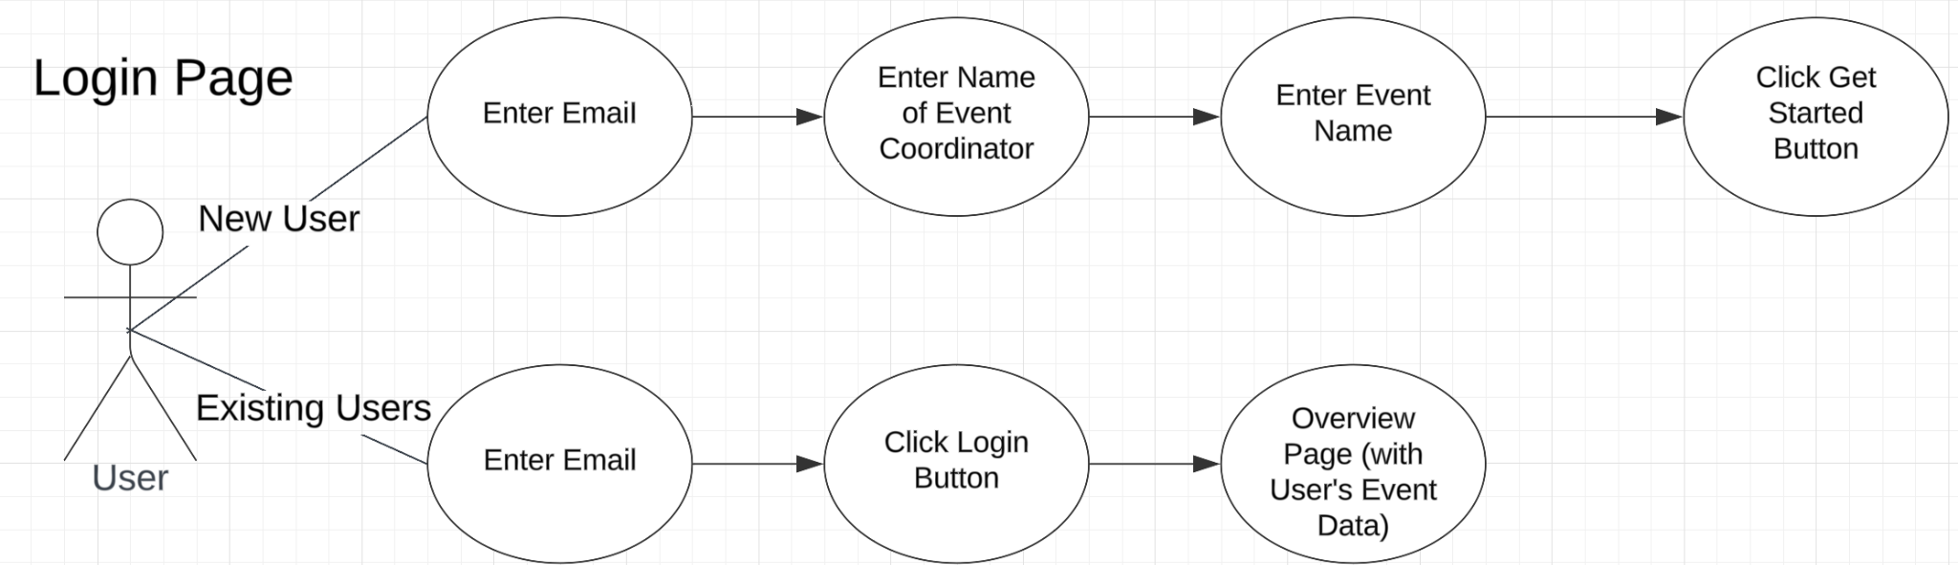
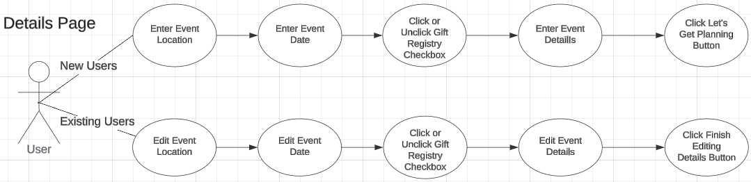
Design Document Key Sections (cont.)
Created Use Cases for Each Page

Slide 11
User Documentation Key Sections
Installation: You are able to use the application on Replit or you can download it from Github. If you download it from Github, you will have to run it by using an interpreter like Visual Studio.
User Guide: We created guides for each page to show the user how you would interact with the program. We will show you how to interact with the program by using a live demonstration later in the presentation.

Slide 12
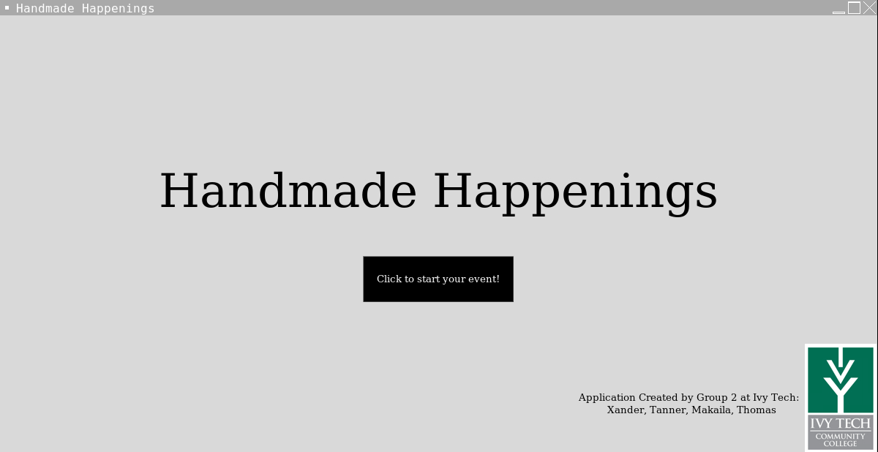
Project Summary Information
Software was developed in Replit and coded in Python
Software has a home, login, detail, budget, to-do, contact, and overview page
Software aimed to be a robust event planning application that will save events and budget them for the user

Slide 13
List of Tools Used for the Project
Communication Tools: Discord and Trello
Discord: Allows us to communicate with each other using text, voice call, or video calls
Trello: Allows us to separates tasks for each team member to see who is doing what for the week
Collaboration Tools: Google Docs and Replit
Google Docs: Allows all of us to collaborate at the same time with each of our group members on a single document
Replit: Allows all of us to collaborate on the project code together at the same time
Various Other Tools:
Youtube videos, Online tutorials, Internet Searches, and more all helped us along the way

Slide 14
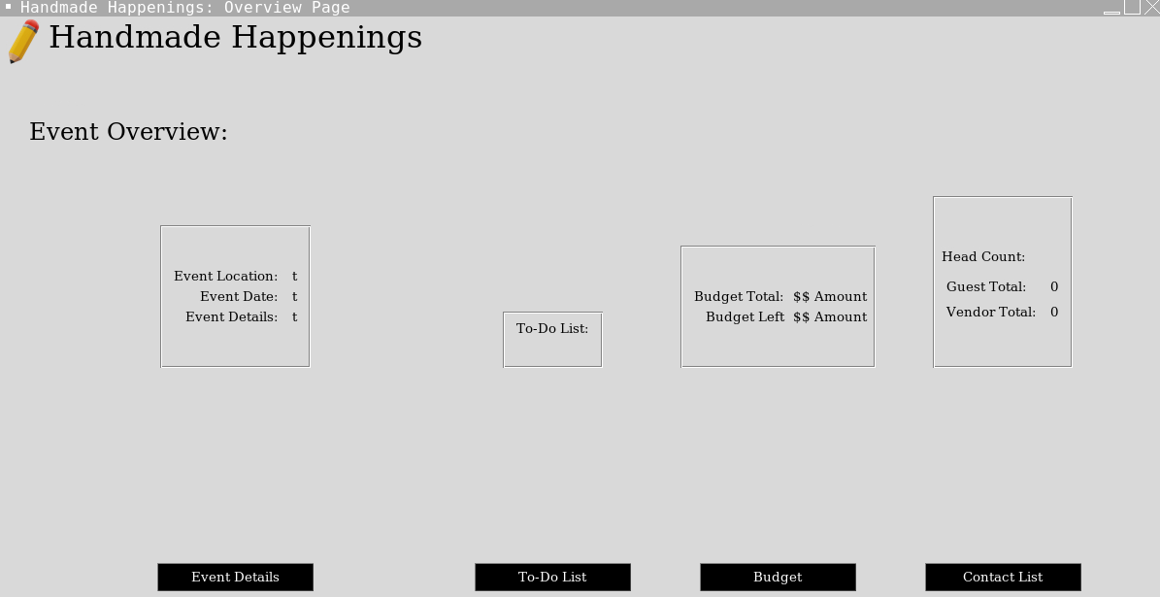
Application Component Summary
Successes
Can go from page to page
Budget works as intended
People are saved into the software
Overview page displays everything efficiently and elegantly
Can go back to any page to add new things into the event that will display on the overview page

Slide 15
Application Component Summary
Attempts (Partial Successes)
Able to display the event details but were not able to display the users name
New users work but they don’t save in the database

Slide 16
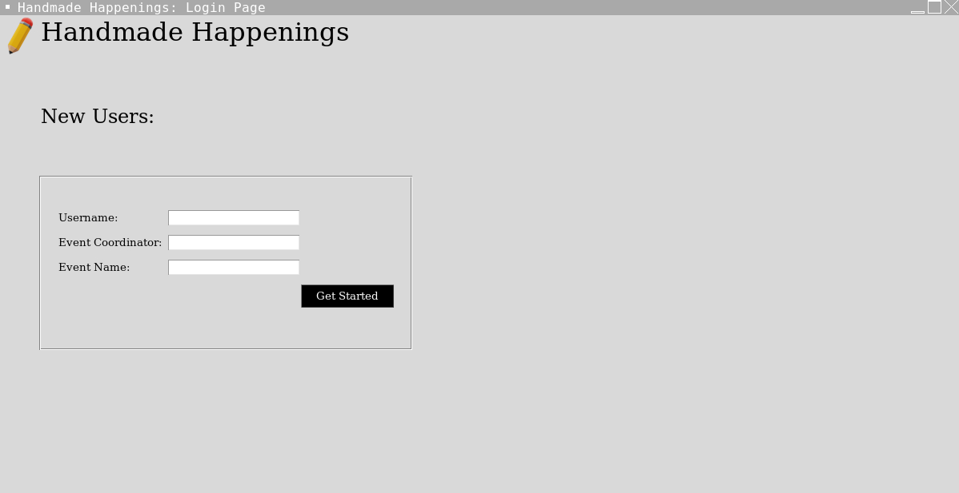
Application Component Summary
Failures
Making the application remember the users after they close the application

Slide 17
Live Test of Application
Application Test will be ran on Replit
Application Test will be conducted by Xander Jewell
Application will be tested by using test data that will show what you can do in the application

Slide 18
Future Enhancements to the Project
Log-in Capability
Adding a Gift Registry
Updating different aspects of the event
Allowing users to have multiple events

Slide 19
“FAQ’s” (That haven’t been asked yet)
How do I run the project?
With Replit
Without Replit
What was the biggest challenge in creating the project?
Data management was very difficult. From saving things to the database to pulling information between pages, there were parts that were rather difficult to manage
Why did you choose to do the project the way you did?
All of the group was comfortable with the idea pitched by Makaila and at least semi-fluent in python and it just flowed from there.
Why can’t I use the program to do X?
Either X was a feature we didn’t even think about, or we ran out of time. Either way, if this were more than just an assignment, we would be using your feedback to further improve the project

Slide 20
“FAQs” Cont.
What was the software development cycle for you?
We used a form of agile methodology, every week holding meetings to set objectives and priorities, and we were constantly evaluating. We built our program piece by piece as well, rather than as one big whole.
Why did you choose Replit?
Replit is essentially google docs for code. Hosting with Replit worked because some of us were already familiar with it and it saved us from having to manage push and pull requests when hosting.
What was the biggest change from your initial vision?
The two biggest changes were removing to permanent save data, since we were having trouble with the database saving between sessions or modifying the data control structures pretty extremely (doing away with classes entirely.

Slide 21
Q&A for the Group
Ask away.
Github Link: https://github.com/XanderJ08/SDEV265ProjectFinal-Group2
Youtube Link To Video: https://www.youtube.com/watch?v=asVIU-j7bN8

